Slide 1
SQL Server Days 2011
Indexing Internals
Denny Cherry
mrdenny@mrdenny.com
twitter.com/mrdenny

Slide 2
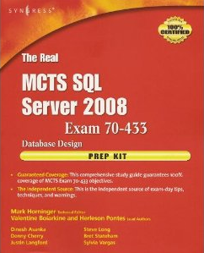
About Me
Author or Coauthor of 5 books
8+ SQL Mag articles
Dozens of other articles
Microsoft MVP since Oct 2008
Microsoft Certified Master
Founder of SQL Excursions
Independent Consultant

Slide 3
What we’ll be covering…
Clustered Indexes
Non-Clustered Indexes
Filtered Indexes

Slide 4
What we won’t be covering…
Spatial Indexes
Full Text Indexes
Compressed Indexes
Columnar Store Index

Slide 5
Structures…
Indexes are made up of B-Trees which make the index navigable
Indexes are almost always made up of at least two data pages.
A Root Page
A Leaf Page
Clustered Indexes also have Data Pages
Lets look at a pretty picture…

Slide 6
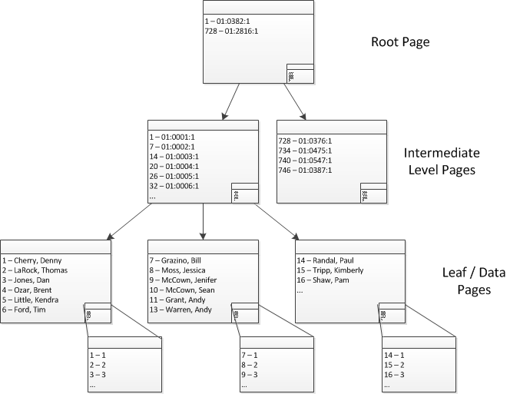
Clustered Index

Slide 7
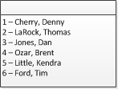
Clustered Index Data Page
Contains one row for every row in the table
Contains all in row data
Contains pointers to out of row data
TEXT
NTEXT
IMAGE
Contains pointers to overflow data
XML
VARCHAR(MAX)
NVARCHAR(MAX)
VARBINARY(MAX)

Slide 8
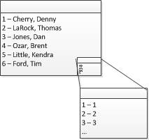
Slot Array
Shows what row within the page each row occupies
Contains the Clustered Index value and row id only

Slide 9
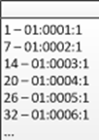
Clustered Index Intermediate Levels
Contains one row, for each page below it
Each row contains…
Clustered Key Value
File Id (2 bytes)
Page Id (4 bytes)
Row Overhead (At least one byte)
Slot array location within this page (2 bytes)

Slide 10
Row Overhead?
1 Byte by default
Nulls?
Variable Width Data Types?

Slide 11
Clustered Index Root Page
Only a single root page can exist
Contains one row, for each page below it
Each row contains…
Clustered Key Value
File Id (2 bytes)
Page Id (4 bytes)
Row Overhead (At least one byte)
Slot array location within this page (2 bytes)

Slide 12
Navigating The Clustered Index

Slide 13
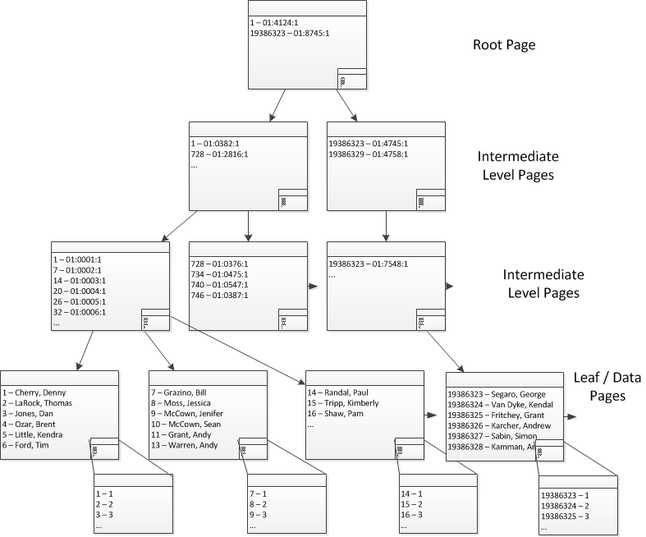
Splitting the Root Page

Slide 14
Uniqueifier …
Non-Unique clustered indexes have an extra column called the uniqueifier which ensures that values within the index are unique.
Uniqueifier is only used for rows which are not unique.
EmpId | Uniqufier
1
2
3
4 | 0
4 | 1
5
6
7 | 0
7 | 1
8

Slide 15
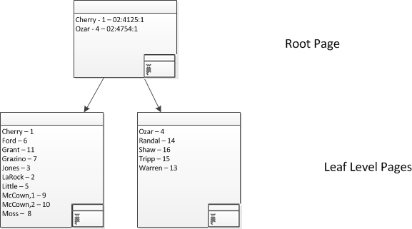
Non-Clustered Index

Slide 16
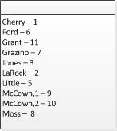
Nonclustered Index Intermediate Page
Contains one row for every row in the table
Contains indexed value and clustered index key or RID

Slide 17
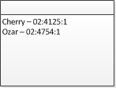
NonClustered Index Root Page
Only a single root page can exist
Contains one row, for each page below it
Each row contains…
Indexed Key Value
Clustered Key Value or RID (if index is not unique)
File Id (2 bytes)
Page Id (4 bytes)
Row Overhead (At least one byte)
Slot array location within this page (2 bytes)

Slide 18
Navigating The NonClustered Index

Slide 19
Navigating The Clustered Index

Slide 20
B-Tree Sizes
Each B-Tree page can store info about X child pages…
INT = 8096/13 bytes = 622 pages
BIGINT = 8096/17 bytes = 476 pages
GUID = 8096/25 bytes = 323 pages

Slide 21
Sample Index Size
Sample table has a clustered key which is an Integer.
Root Level = 1 page
Intermediate Level = 7 pages
Data Pages = 11233 pages
Another page level requires 7,650,600 data pages for a fourth level

Slide 22
Denny Cherry
mrdenny@mrdenny.com
www.mrdenny.com

